Slide 2
What can I do with a Raspberry Pi
By: Mike Linnen @mlinnen www.protosystem.net mlinnen@protosystem.net

Slide 3
Agenda
What is a Raspberry Pi
Fun Projects
Internet of Things
First time setup
Notes:
Answer the question What can I do with a Raspberry Pi?
More importantly is what can’t you do with a Raspberry Pi

Slide 4
Got Kids?
FIRST Robotics Competition (FRC)
Non-Profit Co. sponsoring robotic competitions to teach kids about engineering
2,727 teams/robots
68k high school students
54 regional events, 4 qualifying champ, and 40 district events
Software manages robotics competition (scheduling, ranking, lights , automated real-time scoring, monitoring robots)
http://www.USFIRST.org

Slide 5
What is a Raspberry Pi
Credit card sized single board computer
Teach computer science in schools at an affordable price
Grade School, Middle School & High School
Design and Development started in 2006
Raspberry PI Foundation founded in 2009
Release to Market Feb 2012
3 Million sold by June 2014
Notes:
In 2.25 years 3 million sold

Slide 6
Hardware
Raspberry PI Model A $25 – 256 MB Ram, 1 USB, No Ethernet, GPIO 26
Raspberry PI Model B $35 – 512 MB Ram, 2 USB, Ethernet , GPIO 26
Raspberry PI Model B+ $35 - 512 MB Ram, 4 USB, Ethernet, GPIO 40
All have HDMI Out with Audio
All have Audio Jack out

Slide 7
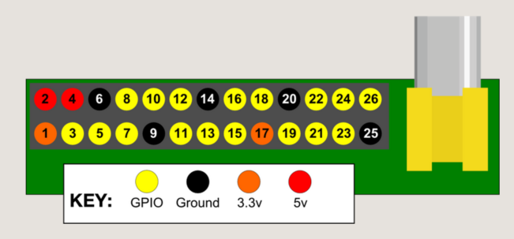
Components
Ethernet
Micro USB Power
USB 2.0
HDMI
RCA Video
Audio
GPIO
Camera Connector
Status LEDs
Notes:
Pass around the broken Pi

Slide 8
Operating Systems/Emulators
New out of the Box Software (NOOBS)
Raspian (Debian)
Pidora (Fedora)
Archlinux
Risc OS
RaspBMC
Openelec
Other Linux Based Distributions
Robot Operating System (ROS)
Android
Emulators
MS-DOS
ZX Spectrum
Commodore 64
Notes:
Most popular Raspbian
ROS is a lot like Microsoft Robotics Studio (Service Oriented)

Slide 9
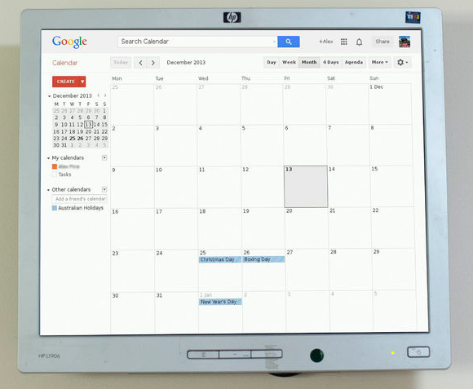
Wall Mounted Google Calendar
http://tinyurl.com/PiLiveCalendar
Notes:
Not touch friendly
Virtual Keyboard
Add appointments on you phone or tablet and they show up on the wall

Slide 10
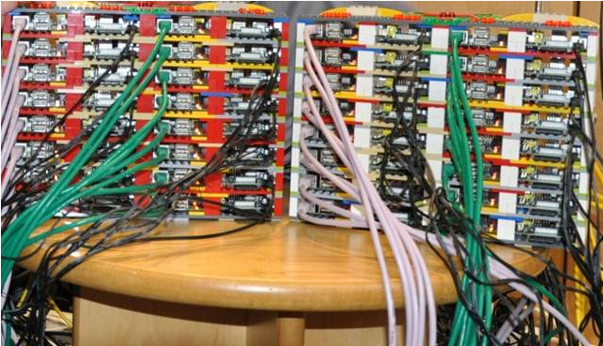
64 Node Supercomputer
http://tinyurl.com/SuperComputerPi
Notes:
University of Southhampton in UK
64 Raspberry Pi’s
Legos to hold them together
Low power/Portable
Hadoop
MPI - Message Passing Interface

Slide 11
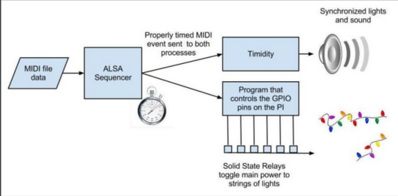
Christmas Light Show
http://tinyurl.com/PiLightShow
http://tinyurl.com/PiLightShowVideo
Notes:
Raspberry Pi synchronized Christmas Light show using midi
Timidity is a midi synthesizer
Video
https://www.youtube.com/watch?v=Fb8107XZ8oI#t=12

Slide 12
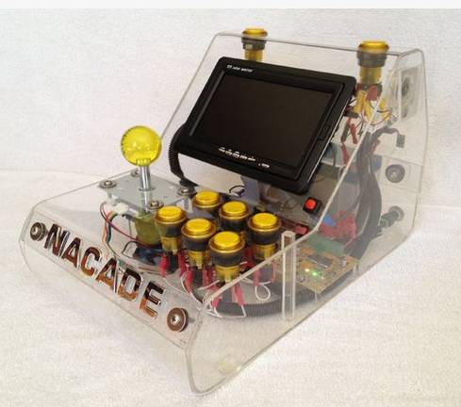
Arcade - MAME Gaming Console
MAME – Multiple Arcade Machine Emulator
Uses images of the original arcade ROMs

Slide 13
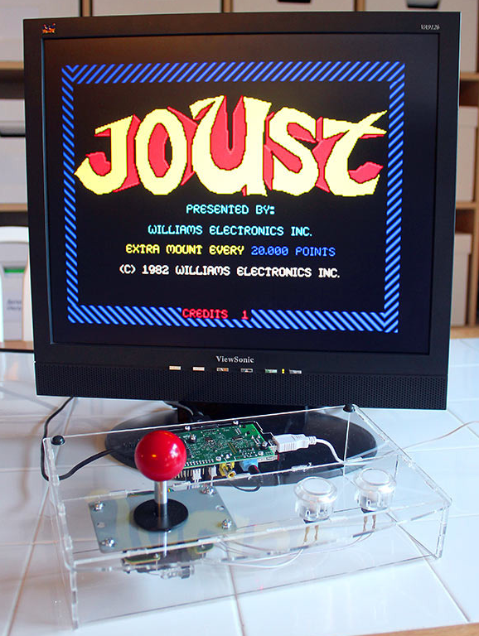
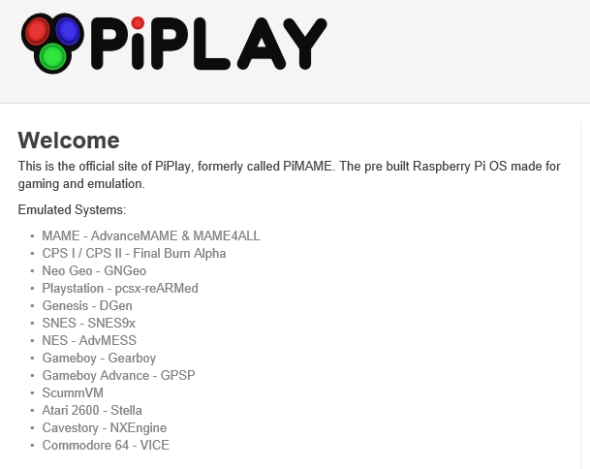
DIY – Retro Gaming with Raspberry Pi
https://learn.adafruit.com/retro-gaming-with-raspberry-pi/overview

Slide 14
Demo – MAME Gaming Console

Slide 15
Programming the Raspberry Pi
Scratch – graphical programming environment
Python 2 or Python 3
C# using Mono
C/C++
Java
Javascript/Node
Perl
Go
……

Slide 16
Python as a programming language
Python 2 or Python 3?
Object Oriented
Internet protocols (HTTP, FTP, SMTP, TCP/IP, POP, IMAP)
Unit Testing, Debugging and Profiling
Extensible via Modules or write you own c/c++ extensions

Slide 17
Broken Build Notification
Continuous Integration Build
Raspberry Pi to Alert the team who broke the build
Python

Slide 18
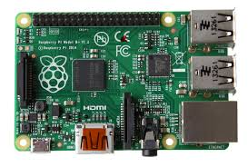
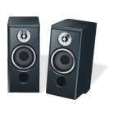
Broken Build Notification
Raspberry Pi

Slide 19
Broken Build Notification
Raspberry Pi
Visual Studio Online REST API

Slide 20
Broken Build Notification
Raspberry Pi
Visual Studio Online REST API
Google Translate Text to Speech API

Slide 21
Broken Build Notification
Raspberry Pi
Visual Studio Online REST API
1
Requested By, Build Name
Google Translate Text to Speech API

Slide 22
Broken Build Notification
Raspberry Pi
Visual Studio Online REST API
2
Google Translate Text to Speech API
Text to Convert

Slide 23
Broken Build Notification
Raspberry Pi
Visual Studio Online REST API
Google Translate Text to Speech API
MP3
3

Slide 24
DEMO: Broken Build Notification
Notes:
protosystem.visualstudio.com
m_linnen@Hotmail.com login
introToRaspberyPi project
Show the code

Slide 25
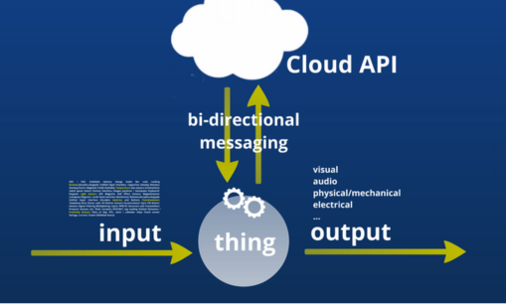
IoT – Internet of Things
Thing - Embedded Devices
Input - Sensors
Output - Actuators
Messaging - Machine 2 Machine communications
Cloud Services – Connector of Things
Gartner Forecasting 26 billion devices by 2020
Massive amounts of data

Slide 26
Patterns for IoT Communications
Device (Thing) is a server that accepts inbound requests
Device (Thing) is a client that connects to a service
Device (Thing) is a client that connects to a broker

Slide 27
Patterns for IoT Communications
Device (Thing) is a server that accepts inbound requests
Easy to do by setting up a webserver on the device
Ok for internal networks
Need to open up ports on router/firewall
Can be insecure
Device can become overloaded with requests
Tight coupling between the Device and whatever is communicating to it

Slide 28
Patterns for IoT Communications
Device (Thing) is a client that connects to a service
More secure than #1
No need for ports to be opened up on router/firewall
Device controls how fast it can process messages
Device is still tightly couple to service

Slide 29
Patterns for IoT Communications
Device (Thing) is a client that connects to a broker
More secure then #1 (only outbound requests)
No need for ports to be opened up on router/firewall
Device controls how fast it can process messages
You need a message broker between Thing and Service
Decouples Thing from Service
Publish/Subscribe model
Multiple Subscribers
Things can communicate to Things without a Service in between

Slide 30
Broker Types
Local broker
Not really IoT
Ok for internal networks
Remote broker
What if your internet access is down?
Local and Remote broker
Higher reliability on internal network
Allows for remote access when needed

Slide 31
IoT Doorbell Ringer
3 Raspberry Pi’s distributed around the house
Doorbell pushed causes MP3 to be played on all 3 Pi’s
Connected Via MQTT message bus using a Remote Broker

Slide 32
Demo: IoT Doorbell Ringer
Raspberry Pi
Raspberry Pi
MQTT Remote Broker
Pub/Sub
Back
Raspberry Pi
Front
Upstairs
Notes:
3 Pi’s connected via an MQTT Broker located in a cloud service
Cloud is not doing anything interesting except connecting the devices
Client02
Cd doorbell/mqtt/python
Sudo python pub_ring.py
Client01
Sudo python sub_ring.py
MediaServer
Sudo python sub_ring.py

Slide 33
Code: pub_ring.py

Slide 34
Code: sub_ring.py

Slide 35
Node-RED (nodered.org)
Notes:
MediaServer
LED + on pin 11
LED – on pin 6 GND
Cd node-red
sudo node red.js
http://mediaserver:1880
Use left & right mouse click to get the properties dialog open
Create an MQTT input with
test.mosquitto.org 1883
protosystemdemo/doorbell/ring
Create a switch on payload with 2 outputs 1=out 1 2 = out 2
Create a 3 sec trigger on out 1 – goes high then 3 secs later go low
Create a 6 sec trigger on out 2 – goes high then 6 secs later go low
Create a rpi-gpio output GPIO pin 11

Slide 36
How would you enhance this doorbell?
When no-one is home play a barking dog along with the doorbell
Add a camera to take a snapshot of the person at the door
When it is after midnight ignore all doorbell ringing
If it is dark outside turn on a an outside light
Add a microphone to each Pi and use them as an intercom
Send text messages when the doorbell rings
Add other sensors like temperature, light, and motion.

Slide 37
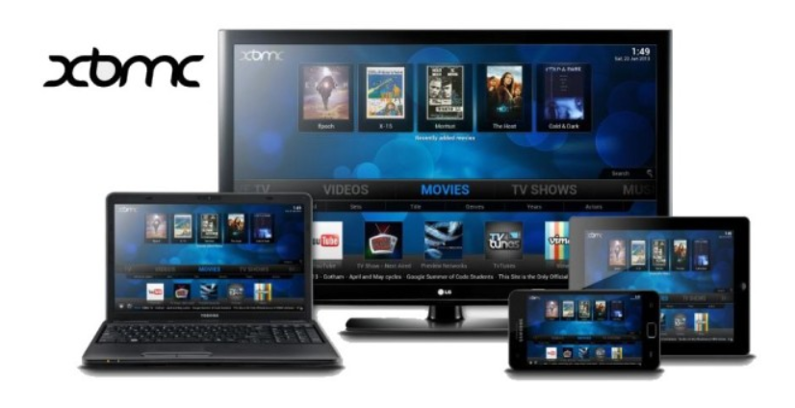
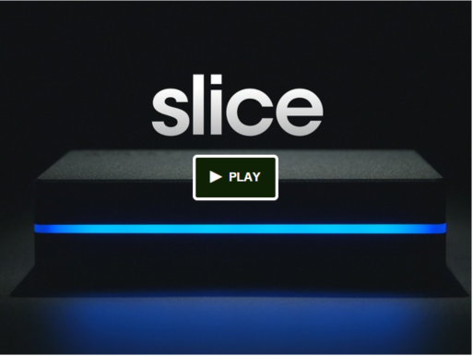
Media System - XBMC
Music
Movie
Stream
Pictures
PVR
Raspberry PI cheap Media System
NOOBs has OpenELEC and RaspBMC

Slide 38
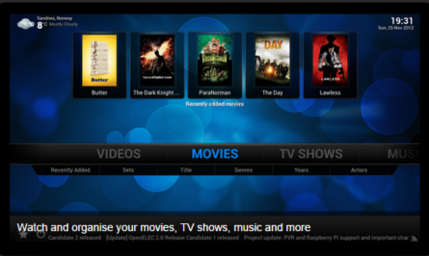
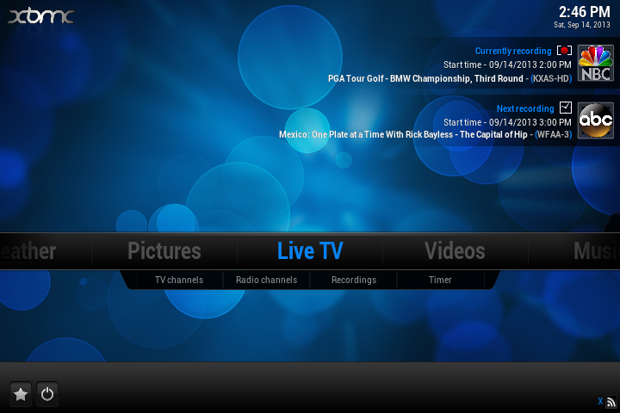
Demo: Raspberry Pi & XBMC
SMB Shares
MySQL
Movie & Music DBs
Raspberry Pi
Raspberry Pi
Notes:
Show shares on either Pi
All content on SMB shares
MySQL on Laptop
AdvancedSettings.xml

Slide 39
Multi-Room Audio - Sonos

Slide 40
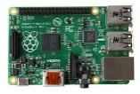
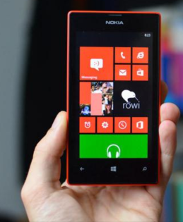
DEMO: Multi-Room Audio Raspberry Pi
Logitech
Media Server
Raspberry PI (A)
Squeezelite Player
Family Room
Raspberry PI (A)
Squeezelite Player Deck
Raspberry PI (B)
Squeezelite Player Bonus
Raspberry PI (C)
Notes:
http://mediaserver:9000 for the media server webpage
sudo service logitechmediaserver restart – to restart the service after boot up cause internet radio doesn’t work on first time boot
Start Squeeze Box Lite client on the Media Server device
/usr/bin/squeezelite-armv6hf -n FamilyRoom -m 00:04:20:00:00:01
Start Squeeze Box Lite client on the Client02 device
/usr/bin/squeezelite-armv6hf -n Deck
sudo alsamixer – to change the audio volume and device
Demo
Show two players exist
Play local music on 1st player
Play local music on 2nd player
Synchronize the players
Play streaming music on both players

Slide 41
DEMO – Setup a new Squeezelite client
Notes:
sudo alsamixer sets up the audio mixer and adjusts the sound level
mkdir squeezelite cd squeezelite
wget http://squeezelite-downloads.googlecode.com/git/squeezelite-armv6hf
sudo mv squeezelite-armv6hf /usr/bin
cd /usr/bin
sudo chmod a+x squeezelite-armv6hf
/usr/bin/squeezelite-armv6hf -n Bonus

Slide 42
First time setup (what do you need?)
USB Keyboard
USB Mouse (only needed for the windowing environment)
Compatible SD Card (Class 4 or better 8 GB)
SD Card Reader
Unless you got a pre-loaded SD Card
HDMI, HDMI to VGA or HDMI to DVI Cable
Monitor/TV that accepts an HDMI, DVI or VGA Cable input
Ethernet Cable

Slide 43
First time setup (tips)
Use NOOBS to get started
When formatting SD card don’t select your external USB drive by mistake
Install multiple OS Distros to the same SD Card
8 GB card can hold 3 OS’s
16 GB card can hold all OS’s
Set keyboard to US (default is British)
Set Time Zone
Set the HostName
Install SAMBA for joining to Windows networks
Clone SD Card when setup is complete as a backup

Slide 44
DEMO - First Time Setup
Notes:
pi/ and pword
sudo – super user Do, elevates privileges
sudo raspi-config
Change User Password
Change Timezone
Change keyboard layout -> Generic 104-key PC
Change hostname -> Advanced Options -> Host Name -> Demo
Verify ping/PuTTY and Windows explorer cannot see the Raspberry Pi
apt-get update – resynchronize the package index files from their sources
apt-get –u upgrade – shows what can be installed
apt-get upgrade – installs the newest versions of all packages currently installed
sudo apt-get update/upgrade
sudo apt-get install samba
sudo apt-get install samba-common-bin
Use PuTTY to remote into Pi to edit file
nano – a simple text file editor
sudo nano /etc/samba/smb.conf
change workgroup & wins support
add [pihome] section
sudo smbpasswd –a pi
sudo service samba restart
Test ping/PuTTY and Windows Explorer
sudo apt-get install xrdp
Demo x-windows

Slide 45
DEMO - Good to know commands
Notes:
man sudo manual for a comand
chmod – sets rights to a file or folder
ls/cd/mkdir/rmdir – basic file/directory manipulation
Command completion
apt-get remove –y wolfram-engine – removes installed packages
sudo shutdown –h now
wiringpi
gpio mode 14 down (pin 23)
gpio mode 10 down (pin 24)
gpio readall

Slide 46
Tools nice to have
SD Formatter – prepare the card for an OS
Win32 Disk Imager – backup/restore SD card images
Router – DHCP Table shows Raspberry Pi’s IP address
PuTTY – windows remote ssh
VNC or xrpd – remoting into linux windowing environments

Slide 47
Raspberry Pi vs Netduino/Arduino
 | Raspberry PI B (B+) | Netduino Plus 2 | Arduino Uno
Type | Mini-computer | Microcontroller | Microcontroller
OS | Linux | None | None
CPU | 32 bit 700 mhz | 32 bit 168 mhz | 8 bit 16 mhz
RAM | 256 mb | 100+ kb | 2 kb
GPIO | 8-21 (26) | 22 | 14
Other | 1-PWM, SPI, I2C, 1 UART (2- PWM) | 4-PWM, SPI, I2C, 1 UART, 6-AI | 6-PWM, SPI, I2C, 1 UART, 6-AI
Programming | Python, C/C++, JAVA, C# … | C#, VB.Net | C like
Ethernet | Onboard | Onboard | Add-on
Video | HDMI/RCA | None | None
Audio | Stereo Out, USB Mic | None | None
USB | 2 (4) | 1 | 0
Cost | $42 - $37 Pi & $5 SD Card | $59.95 | $24.99
Notes:
At first glance Pi cost looks lot less
Netduino/Arduino for low level work
Raspberry Pi is field updatable

Slide 48
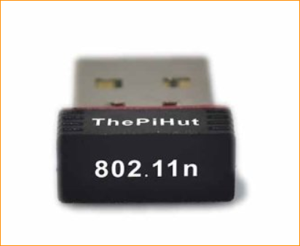
Accessories – Wifi USB
$5
Great for areas that don’t have Cat-5

Slide 49
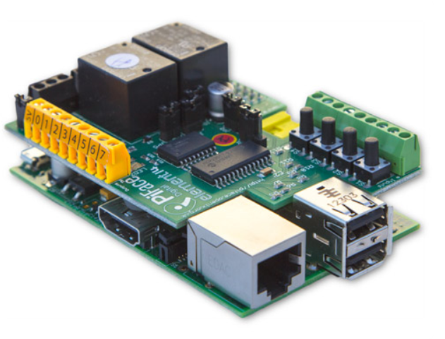
Accessories – PI Face
Expansion Board sits on top of the PI
2 Relays
8 Outputs
8 Inputs
8 LED
4 Switches
$35
Great for prototyping

Slide 50
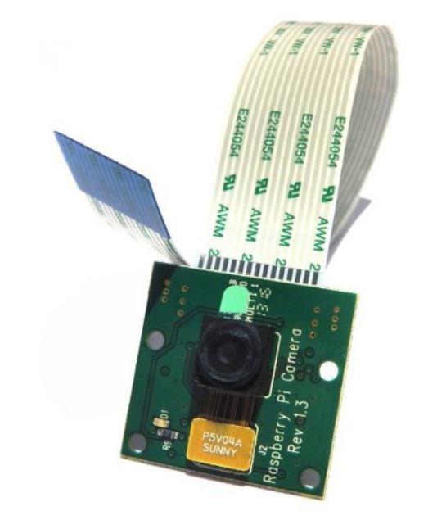
Accessories - Camera
Connects to PI via special port
5 mp Camera
1080p 30 fps
$28

Slide 51
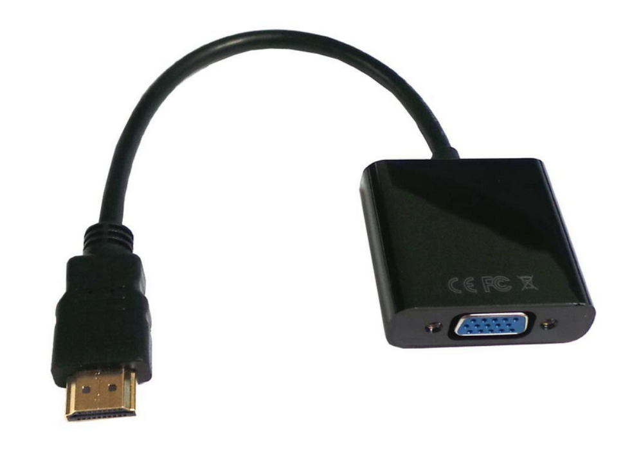
Accessories – HDMI to VGA
Hook up Raspberry PI to a non-HDMI monitor
$8

Slide 52
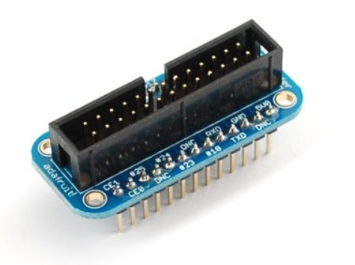
Accessories – Breakout board
Easily hook up PI to breadboard
$9

